Slide 1
Teaching
Construction Trades in High School

Slide 2
1995 Nonconnah Blvd Memphis, TN 38132 901-794-9212
West Tennessee Chapter Associated Builders and Contractors
Amber Harris
Director of Education
amber@wtcabc.org

Slide 3
Associated Builders & Contractors West Tennessee Chapter
ABC is a national association with 70 chapters nationwide representing 21,000 merit shop construction and construction-related firms.
ABC also operates a Department of Labor approved Apprenticeship program which uses NCCER to offer 12 trades.

Slide 4
WHY IS ABC HERE???
America Needs Skilled Workers
Currently, only one tradesman/construction worker is entering the industry for every five that leave.
That means you can earn competitive pay at a young age — without worrying about student loan debt.

Slide 5
Qualified skilled tradesmen make an average of
$50,000 annually

Slide 6
Average Salaries
Power Line Worker- $62,280
Mason- $57,830
Welder- $56,904
Electrician- $53,294
Ironworker- $53,291
Heavy Equipment Operator- $52,759
Carpenter- $48,756
HVAC Tech- $45,830

Slide 7
Benefits to a Career in Construction
High Pay
Flexible Schedule
Advancement
Travel Opportunities

Slide 8
By 2018, fields like construction will provide nearly
2.7 million of which will require a
post-secondary credential.
8 million job openings
Notes:
For 5 straight years, skilled crafts have remained the toughest positions to fill. This is in spite of the industry’s upward mobility and high earning potential.

Slide 9
Where Do You Begin?

Slide 11
NCCER
Nationally recognized certifications
Can be completed in 2 yrs., instead of 4 yrs.
NCCERconnect
Wallet Card & Certificate
College Credit

Slide 12
NCCER Crafts Available
Notes:
*If you earn certifications during high school, you will have a head start on others who are entering the trade
*Your certifications will make you more employable starting out

Slide 13
NCCER in High School
ABC ALREADY works directly with SCS to provide NCCER training to students
Southwest Career & Technology Center
Germantown High School
Bolton High School
Cordova High School
Havenview Middle
Kingsbury CTC
Kirby High School
Manassas High School
Sheffield High School
**We also oversee programs in Hardeman County Schools
Notes:
*If you earn certifications during high school, you will have a head start on others who are entering the trade
*Your certifications will make you more employable starting out

Slide 14
What Can ABC Provide For You?
Guest Speakers from Industry
Go Build/BYF Construction Career Materials
NCCER Program Support & Audits
Materials Donations
NCCER Instructor Training
NCCER Certifications
Field Trip Opportunities
Externship Opportunities
Career Fair Support
Certification for you & your students
ABC handles all paperwork and stores all tests
Additional classroom support
Opportunity to build your own program
Customizable books & curriculum

Slide 15
PROGRAM SUPPORT & AUDITS
FORM 105
Self-Assessment/Audit Prep

Slide 16
How Do You Become Certified?
3 – Day Certification Class
ICTP (Instructor Certification Training Program)
Certified for 3 years
To Maintain Certification:
Teach at least 1 module every 3 years and submit to NCCER
Next ICTP Course Tentatively Set for Week of Oct. 9th (Fall Break)

Slide 17
Records Transmittal Policy
Shelby County Schools to WTCABC
Registration & Release Forms
A complete Registration & Release Form for each student receiving training must be turned in to WTCABC within 30 calendar days of the first day of each academic year.
Dropped Students
If a student who is already registered with WTCABC as a trainee from a Shelby County School drops a course, notification must be sent to WTCABC within 30 calendar days of the student’s drop date.
Module Completions
All module completions must be submitted to WTCABC on a Form 200 by June 15th for each academic year. Module completions/ Form 200’s may be turned in early or throughout the semester. All original module tests and performance verification profiles must be sent to WTCABC with the corresponding Form 200. No forms will be submitted to NCCER without the corresponding test and PV.

Slide 18
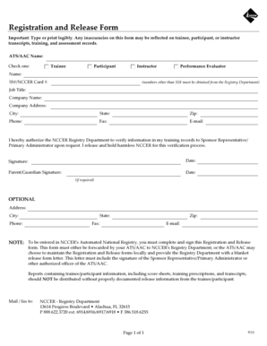
REGISTRATION & RELEASE FORMS
MUST FILL IN:
Student’s Info @ Top
BIRTH DATE
SOCIAL SECURITY NUMBER
Signature of Student & Parent

Slide 19
MODULE EXAMS
CAN BE DOWNLOADED FROM IRC (Instructor Resource Center)
Based on module objectives
Multiple-choice questions
Closed-book
Proctored by:
Master Trainers, Instructors or Curriculum Proctors
Passing Score is 70%
You can make the passing score higher, if you’d like
2- day Retest Policy
Questions may not be added or deleted
Graded exams must be securely filed for a minimum of three years
The security of testing materials is essential.
All scratch paper used during the test must be collected at the end of the exam.
No testing materials can be recorded or photographed.

Slide 20
PERFORMANCE PROFILES
Safety first
Measure skills against performance standard
Download from IRC or NCCER website
Pass/Fail
Ensure trainee understands the task
Has proper tools and materials
Review each step
Retest at the discretion of the instructor
Pe
r
fo
r
m
a
n
c
e
Pr
o
fi
l
e
Sh
e
e
t
(Pa
g
e
1
o
f
1
)
N
C
C
ER
T
r
a
i
n
i
n
g
C
r
a
ft:
C
o
r
e
C
u
r
r
i
c
u
l
u
m
:
I
n
tr
o
d
u
c
to
r
y
C
r
a
ft
Sk
i
l
l
Mo
s
d
u
l
e
:
Mo
d
u
l
e
Se
v
e
n
,
0
0
1
0
7
-1
Mo
5
d
u
l
e
T
i
tl
e
:
B
a
s
i
c
C
o
m
m
u
n
i
c
a
ti
o
n
Sk
i
l
l
s
T
R
A
I
N
E
E
N
A
M
E
:
T
R
A
I
N
I
N
G
P
R
O
G
R
A
M
S
P
O
N
S
O
R
:
I
N
S
T
R
U
C
T
O
R
:
R
a
t
i
n
g
L
e
v
e
l
s
:
(1
)
Pa
sse
d
:
p
e
rf
o
rme
d
t
a
sk
(2
)
F
a
i
l
e
d
:
d
i
d
n
o
t
p
e
rf
o
rm
t
a
Al
so
sk
,
l
i
st
t
h
e
d
a
t
e
f
o
r
t
e
st
i
n
g
f
o
r
e
a
ch
t
a
sk
w
a
s
co
mp
l
e
t
e
d
R
.
e
c
o
g
n
i
t
i
o
n
:
W
h
e
n
t
e
st
i
n
g
f
o
r
t
h
e
N
C
C
ER
T
ra
i
n
i
n
g
Pro
g
ra
m,
b
e
su
re
t
o
re
co
rd
Pe
rf
o
rma
n
ce
t
e
st
i
n
g
re
su
l
t
s
o
t
n
h
e
R
e
g
i
st
ra
t
i
o
n
o
f
T
ra
i
n
i
n
g
Mo
d
u
l
e
s
F
o
rm,
a
n
d
su
b
mi
t
t
h
e
re
su
l
t
s
t
o
t
h
e
T
ra
i
n
i
n
g
Pro
Sp
g
ra
m
o
n
so
r
.
S
T
A
R
O
T
B
J
E
C
T
I
V
E
T
A
S
K
R
A
T
I
N
G
D
A
T
E
E
N
D
T
I
M
T
E
I
M
Pe
E
rf
o
rm
a
g
i
ve
n
t
a
sk
a
f
t
e
r
l
i
st
e
n
i
n
1
t
g
o
o
ra
l
i
n
st
ru
ct
i
o
n
s.
F
i
l
l
o
u
t
a
w
o
rk-re
l
a
t
e
d
f
o
rm
p
ro
vi
d
2
b
e
d
y
yo
u
r
i
n
st
ru
ct
o
r
R
.
e
a
d
a
n
d
i
n
t
e
rp
re
t
a
se
t
o
i
f
n
st
ru
ct
i
o
n
s
f
o
r
p
ro
p
e
rl
y
d
o
n
n
i
n
1, 2
sa
g
a
f
e
t
y
h
a
rn
e
ss
a
n
d
t
h
e
n
o
ra
l
l
i
y
n
st
ru
ct
a
n
o
t
h
e
r
p
e
rso
n
o
n
h
o
w
t
d
o
o
n
t
h
e
h
a
rn
e
ss.
C
o
p
yri
g
h
t
©
2
0
1
5
N
C
C
ER
.
Pe
rmi
ssi
o
n
i
s
g
ra
n
t
e
d
t
o
re
p
ro
d
u
ce
t
h
i
s
p
a
g
e
p
ro
vi
d
e
d
t
h
a
t
co
p
i
e
s
a
re
f
o
r
l
o
ca
l
u
se
o
n
l
y
a
n
d
t
h
a
t
e
a
co
ch
p
y
co
n
t
a
i
n
s
t
h
i
s
n
o
t
i
ce
C
.
O
R
E
C
U
R
R
I
C
U
L
U
M:
I
N
T
R
O
D
U
C
T
O
R
Y
C
R
AF
T
SKI
L
L
S--MO
D
U
L
E
0
0
1
0
7
-1
5
PER
F
O
R
MAN
C
E
PR
O
F
I
L
E

Slide 21
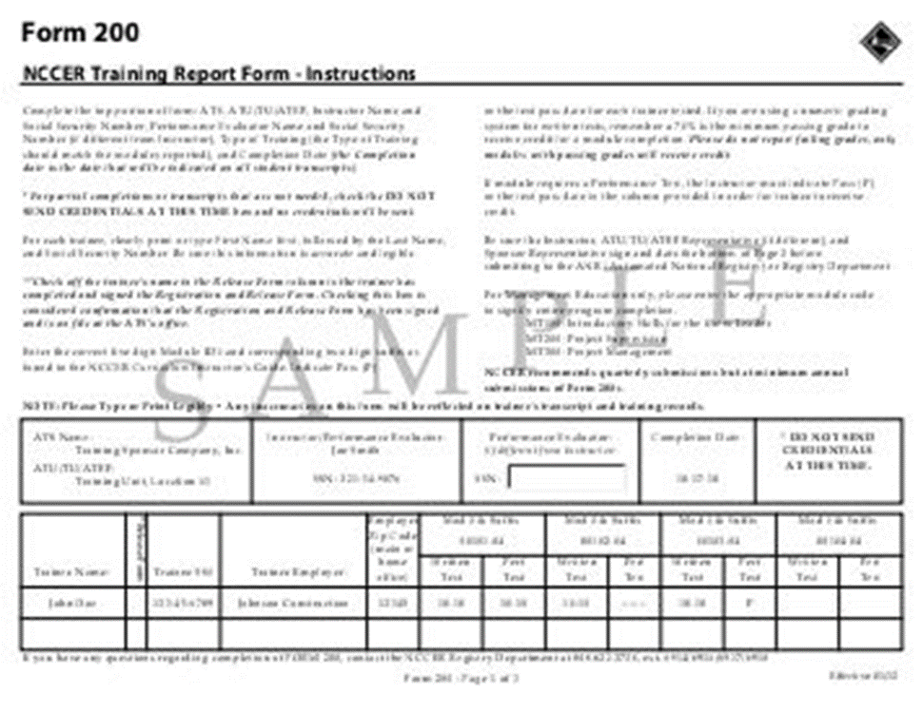
FORM 200’s

Slide 23
ABC Partners
NCCER & BYF
National Center for Construction Education & Research
Build Your Future
www.nccer.org
www.byf.org
Go Build Tennessee
Statewide skilled trades education and recruitment initiative
www.gobuildtennessee.com

Slide 24
GUEST SPEAKERS
CONTRACTORS, TOOL SUPPLIERS, CURRENT & GRADUATED APPRENTICES & OTHER INDUSTRY REPRESENTATIVES
DATE/TIME
TOPIC
# OF STUDENTS
OCTOBER
Careers in Construction Month
ABC WOULD LIKE TO SPEAK TO YOUR STUDENTS IN OCTOBER

Slide 25
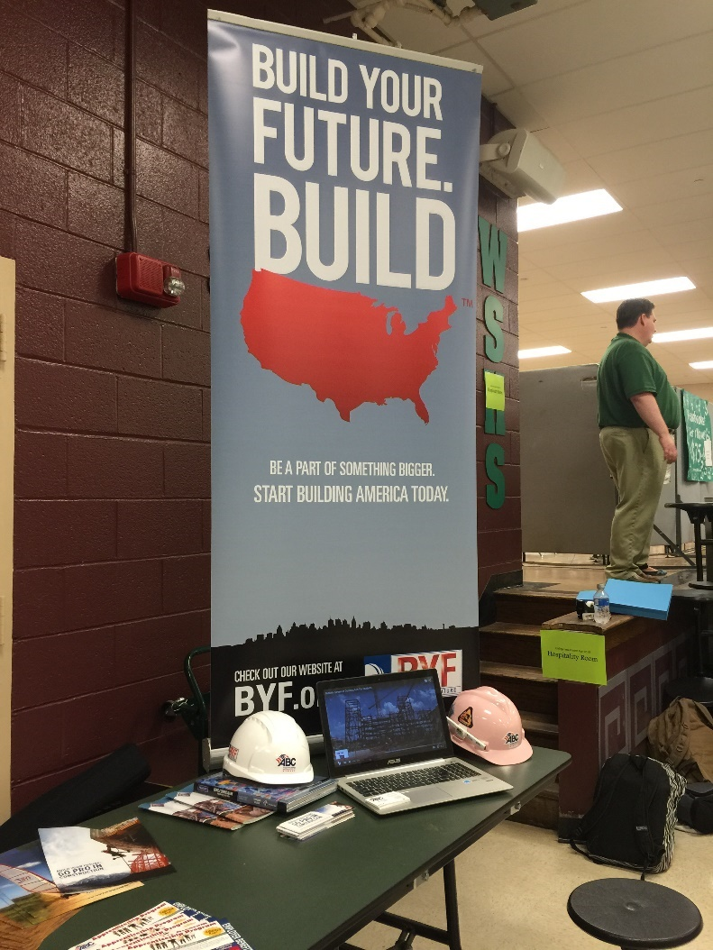
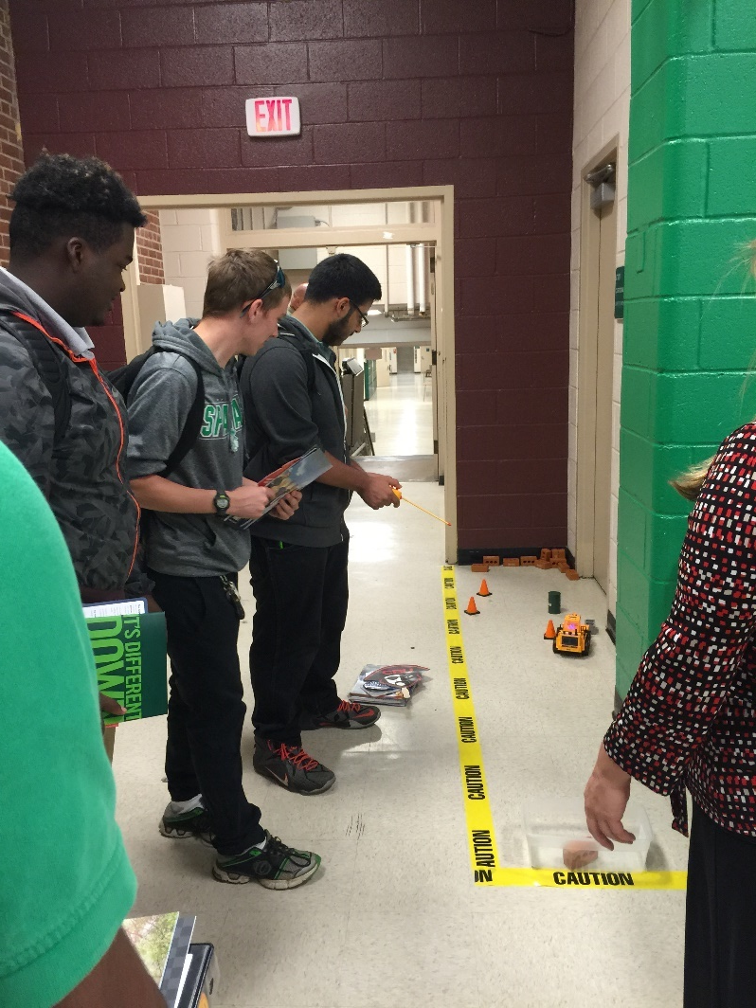
CAREER FAIRS
PLEASE LET ME KNOW WHEN YOUR SCHOOL’S CAREER FAIR IS SCHEDULED FOR & WHO I CAN CONTACT TO PARTICIPATE!

Slide 26
EXTERNSHIPS/INTERNSHIPS
Currently working on developing externships for teachers for the summer of 2018 & internships for students!
If you are interested in helping or participating in either of these programs, please let me know!

Slide 27
WHAT IS AFTER GRADUATION
FOR YOUR STUDENTS?
Notes:
With NCCER, credentials can be used towards college credit- bachelors & master degree through PIMA college.
Educators at all levels are recognizing that employers need employees with skill sets that the conventional four-year college degree does not provide
(National Career Development Association)

Slide 28
Student’s Graduate High School With….
Levels of NCCER Already Completed- Putting Them Ahead in Our Apprenticeship Program & Making Them More Hirable!
Other Options for Post-Secondary Credentials
Education & Industry Certifications
Registered Apprenticeship Programs
Post Secondary Degree Options
Technical School
College or University Degree
Education & Industry Licenses
Notes:
With NCCER, credentials can be used towards college credit- bachelors & master degree through PIMA college.
Educators at all levels are recognizing that employers need employees with skill sets that the conventional four-year college degree does not provide
(National Career Development Association)

Slide 29
Our Goal After Graduation
Help students find a job in the construction field with one of our members
*If hired, the contractor would pay for their apprenticeship in our program

Slide 30
Apprenticeship
An apprentice is a worker who learns a craft through planned work on the job, and classroom learning.
Apprenticeship periods range from 3 to 5 years.

Slide 31
ABC Apprenticeship
Job Placement
Earn while you learn
Each level completed in 6 months
Online, mobile training
Nationally recognized certifications
*Only requirement is that the applicant is at least 18 years old
Notes:
ABC can help you find a job when you graduate, and your new employer will pay for your training

Slide 32
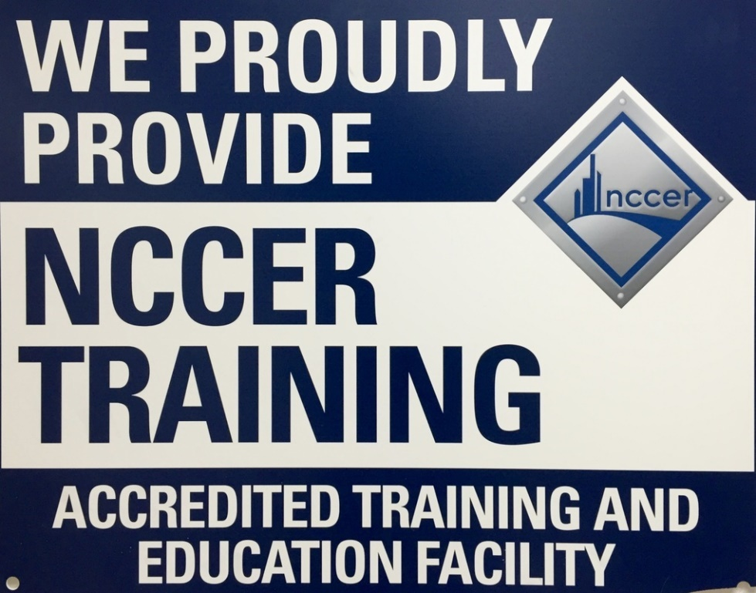
12 Trades
Carpentry
Construction Technology
Electrical
Electronic Systems Tech
Heavy Equipment
HVAC
Masonry
Pipefitting
Plumbing
Scaffolding
Sheet Metal
Welding

Slide 33
Forget digging ditches, construction is about the technical expertise of the craft professional.
It’s about building America!
QUESTIONS?

