Slide 1
Structural Systems
Program of Study

Slide 2
College, Career, and Technical Education
Trade and Industry
Architecture and Construction Career Cluster
Structural Systems Program of Study

Slide 3
Trade and Industrial Education
Trade and Industrial Education helps prepare students for an increasingly demanding high skilled workplace in the United States.

Slide 4
Trade and Industrial Education
To meet the needs of the technologically changing workplace, the state curriculum has recently been aligned with industry standards, and teachers are often offered professional development opportunities to upgrade their skills to the levels required for instruction according to industry standards.

Slide 5
Trade and Industrial Education
Trade and Industrial Education:
Combines theory with application to develop technical skills, occupational judgments, and workplace ethics.
The courses are closely aligned with those of postsecondary institutions in Tennessee, allowing students to make easier transitions to those state schools.

Slide 6
Trade and Industrial Education
Trade and Industrial Education:
Offers high quality educational experiences to promote teamwork, leadership, high work standards, and help develop a value for lifelong learning.

Slide 7
Trade and Industrial Education
Classes in Trade and Industrial Education require students to develop manipulative skills, safety skills, job judgment, and technical knowledge.
Most of the courses now rely on computer software, and there is a greater use of technology current course competencies.
The program offers six specialized career clusters and programs of study.

Slide 8
Architecture and Construction
Programs of Study:
Residential & Commercial Construction
Structural Systems
Mechanical, Electrical, & Plumbing (MEP) Systems
Architectural & Engineering Design
Interior Design

Slide 9
Structural Systems
Fundamentals of Construction
Structural Systems I
Structural Systems II
Construction Practicum

Slide 10
Program of Study
The Structural Systems program of study prepares students with the knowledge and skills related to residential and commercial carpentry.
Course content covers wood, metal, and concrete building materials, fasteners, hand and power tools, fabrication based on construction plans, framing of platform and post-and-beam structures, stairs, structural loads, installation and trim of windows and doors, installation and repair of gypsum wallboard, exterior finish work, cabinet installation, and thermal and moisture protection.

Slide 11
Program of Study
The fourth level course, Construction Practicum, places students with industry partners to complete a capstone construction project.
Upon completion of the program of study, students will be equipped for workforce entry, apprenticeships, or to continue training at the postsecondary level.

Slide 12
Building Construction Technology
Associates
Civil Technology
Construction Management
University of Tennessee at Chattanooga
Cleveland State
High School Structural Systems Program of Study
CTSO Competitive Events
Certificate
SkillsUSA
Work-based Learning: Career Practicum
Construction Science
University of Tennessee at Knoxville
TCAT Crossville
Bachelors
Concrete Industry Management
MTSU
Architecture & Engineering
Available at many TN universities
Industry Certification
NCCER Core Curriculum
NCCER Carpentry
Apprenticeship
Apprenticeship training is available in carpentry and other related areas.
MTSU
Construction Applications
Cleveland State
Masonry
TCAT Memphis
TCAT Morristown
Residential Building Maintenance
TCAT Paris
TCAT Livingston
TCAT Memphis
TCAT Nashville
TCAT Pulaski

Slide 13
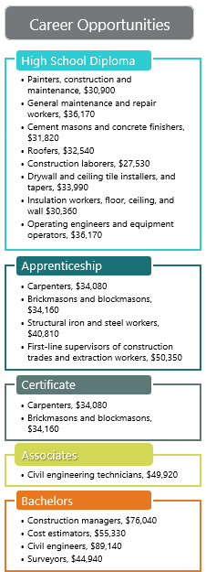

Slide 14
NCCER
Industry Certification
National Center for Construction Education and Research

Slide 15
NCCER
NCCER is a not-for-profit 501(c)(3) education foundation created in 1996 as The National Center for Construction Education and Research.
It was developed with the support of more than 125 construction CEOs and various association and academic leaders who united to revolutionize training for the construction industry.

Slide 16
NCCER
Sharing the common goal of developing a safe and productive workforce, these companies created a standardized training and credentialing program for the industry.
This progressive program has evolved into curricula for more than 70 craft areas and a complete series of more than 70 assessments offered in over 4,000 NCCER-accredited training and assessment locations across the United States.

Slide 17
NCCER
NCCER develops standardized construction and maintenance curricula and assessments with portable credentials.
These credentials are tracked through NCCER’s National Registry which allows organizations and companies to track the qualifications of their craft professionals and/or check the qualifications of possible new hires.
The National Registry also assists craft professionals by maintaining their records in a secure database.

Slide 18
NCCER
NCCER’s workforce development process of accreditation, instructor certification, standardized curriculum, national registry, assessment, and certification is a key component in the industry’s workforce development efforts.
NCCER also drives multiple initiatives to enhance career development and recruitment efforts for the industry.

Slide 19
NCCER
NCCER’s new branding and international initiatives have led to the use of NCCER in lieu of The National Center for Construction Education and Research.
The same great resources and services are still available.

Slide 20
NCCER
NCCER is headquartered in Alachua, Fla., and is affiliated with the University of Florida's M.E. Rinker, Sr. School of Building Construction.

Slide 21
CAREER OPPORTUNITIES
Employment for carpenters is projected to grow by 5 percent in Tennessee between 2014 and 2022 with a total annual average of 200 openings.
Skills students develop in the program of study are transferrable to additional growing occupations related to structural systems listed in the chart to the right.
Opportunities are available in a range of occupations including supervisory roles such as construction manager or first-line supervisor.
Job outlook is positive in all regions of the state; however, more opportunities are available in urban and surrounding areas.

Slide 22
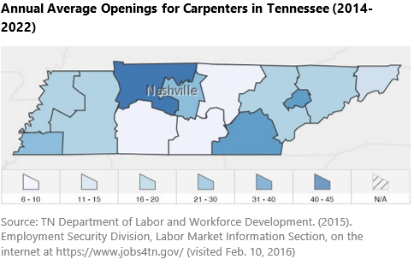
CAREER OPPORTUNITIES

Slide 23
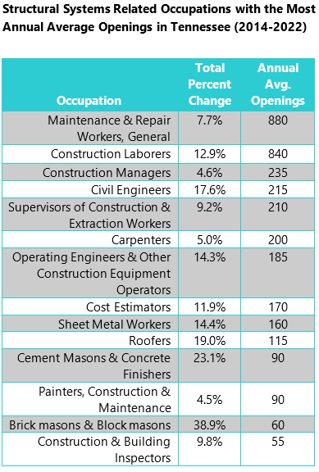
CAREER OPPORTUNITIES

