Slide 1
Demonstrate Knowledge of SkillsUSA History
TN 7.2A
SkillsUSA S-1.5

Slide 2
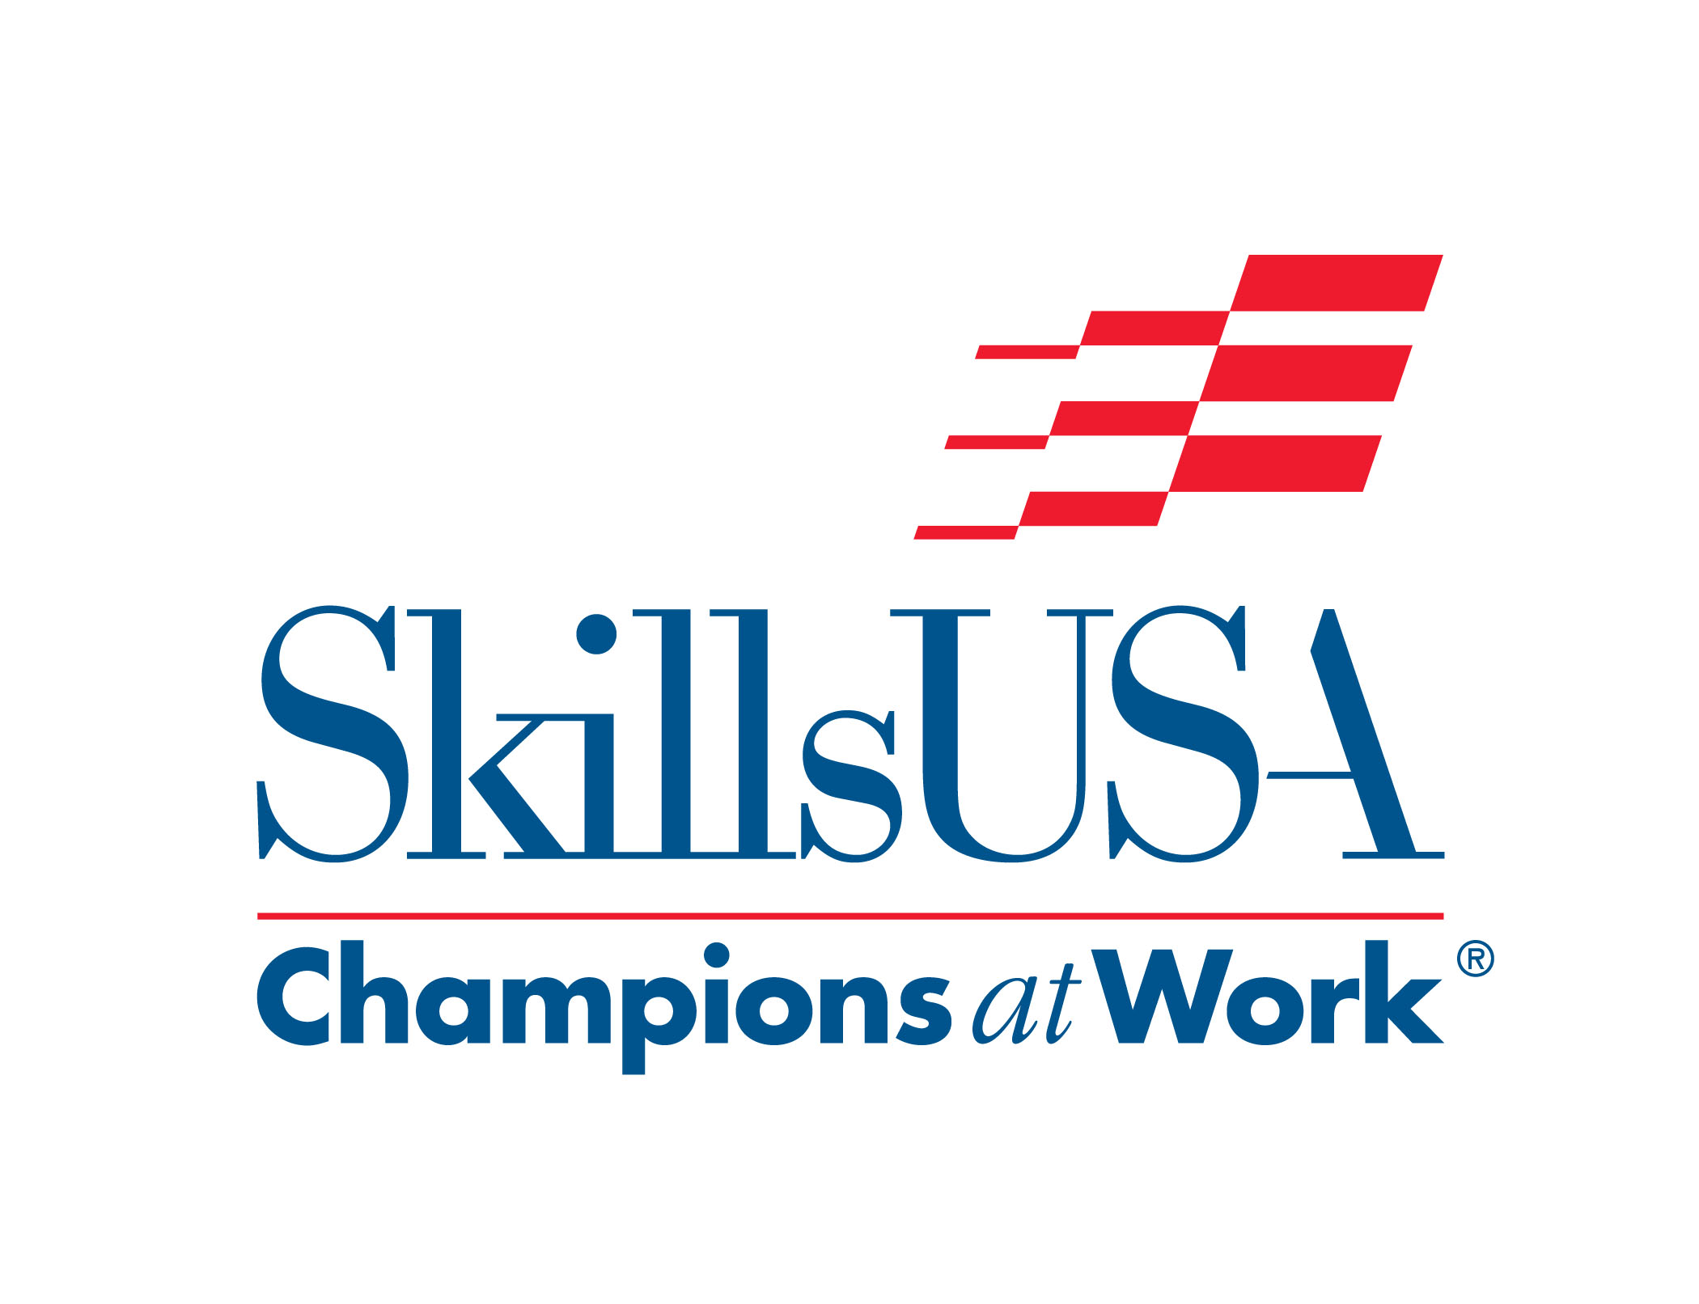
To be an active and effective member of an organization means understanding what the organization is all about.

Slide 3
It means understanding how the organization was formed, why it was formed, and what kind of changes it made as it grew.

Slide 4
It also means understanding the organizational mission and beliefs, because as a member, you share those ideals.

Slide 5
History of SkillsUSA
Since 1965, SkillsUSA has had a positive influence on millions of students nationwide.

Slide 6
SkillsUSA was established as a national organization that now serves high school and college/post secondary students and professional members who participate in training programs for technical, skilled, and service occupations, including health occupations.

Slide 7
Through SkillsUSA, students can learn to foster a deep respect of the dignity of work, and attain a purposeful life.

Slide 8
High standards in trade ethics, workmanship, scholarship, and safety are promoted while students learn to plan, organize, and complete worthwhile projects and activities.

